Slide 1
THE WANDERING CHICAGO
is a recommendation system which integrates accessible resources for homeless residents in Chicago. By collecting data from portal websites, using Google Map API and computing distance based on haversine formula, our software provides users with information about preferred facilities and their locations on the map.
Team members:
Ta-Yun Yang
Xuan Bu
Yuwei Zhang

Slide 2
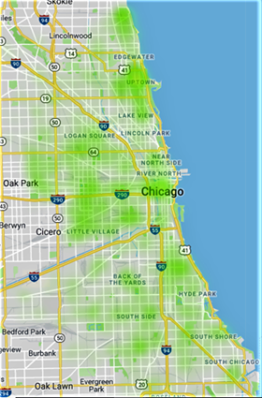

DISTRIBUTION OF FACILITIES AND HAVERSINE FORMULA
The heatmap plots the density of the relevant facilities in Chicago. It indicates that the distribution of those facilities is balanced.
What is Haversine Formula?
It is a formula that determines the great-circle distance between two points on a sphere given their longitudes and latitudes.

Slide 3
WHY WE CHOOSE THOSE DATA?
Shelter
Total Homeless Population: 5450
Health
Received Mental Health Services: 26%
Received Services for Substance Use: 29%
Family
Number of individuals in family: 35%
Domestic Violence Victims: 8.8%
People with HIV: 3.8%
People with Physical Disabilities: 21%
Total Unsheltered population: 1357
Homeless Youth under 24: 31%
Acess to Food Stamp: 56%
Access to Medicare or Medicaid: 37%
Recommended Services: Shelters, Food Pantry, Warming Center
Recommended Services: Health Service, Clinic, Condom Distribution Center
Recommended Services: Family support services
Data Source:
2018 Homeless Point-in-Time Count & Survey Report, City of Chicago

Slide 4
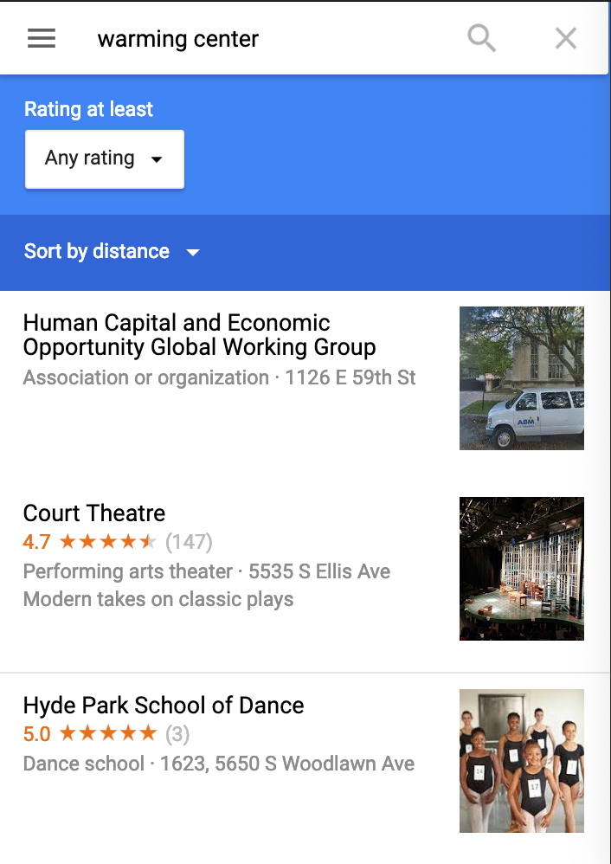
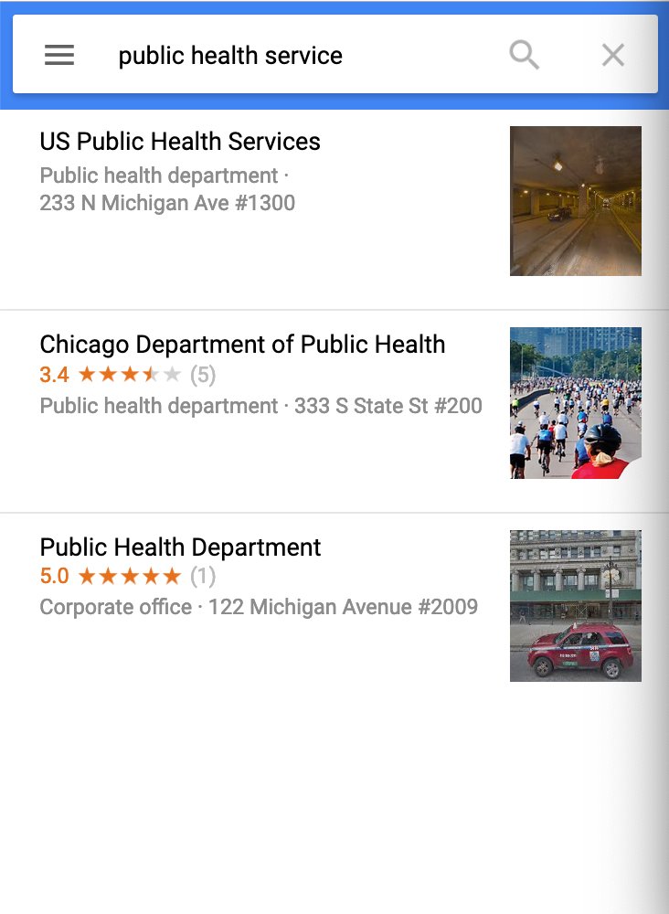
WHY WE NEED THIS SYSTEM?
The results found by Google are not purely related with what a user looks for, which lowers the effectiveness of recommendation based on distance.
Cannot find customized results in the case the user looks for places with specific public services.
Case 1: search for "public health service", which cannot find what the users want.
Case 2: search for “warming center” and order them by distance, the results are poorly related with what the users want

Slide 5
DATA SOURCE
Facility Type | Source | Access
Warming Centers | Chicago Data Portal | Download
Cooling Centers
Park
Senior Centers
Community Service Centers
Condom Distribution Sites
Familiy Support Agencies
Public Health Service Centers
Food Pantry Location | FoodPantries.ORG | Web Crawler
Shelter Location | Homeless Shelter Dictionary
Food Pantry Geocode | Google Map Geocoding API | API
Shelter Geocode

Slide 6
HOW TO USE OUR SOFTWARE?
Step 1
Download data set and py files
Step 2
Input user’s location
Step3
Choose categories, walking time, full_info
Eg: “5730 S Ellis Ave, Chicago, IL 60637” or “John Crerar Library
Input filename (path of data set)
Step 4
Check exported webpage and map

Slide 7
HOW TO USE OUR SOFTWARE?
Sample code
Case 1: default settings
Case 2: choose categories
Case 3: choose walking time
Case 4: choose full info or not
filename = "full_data.csv“
address = "5730 S Ellis Ave, Chicago, IL 60637"
find_facilities.go(filename, address)
find_facilities.go(filename, address, ["shelter", "food pantry", "warming center"])
find_facilities.go(filename, address, ["shelter", "food pantry", "warming center"], walking_time=30)
find_facilities.go(filename, address, ["shelter", "food pantry", "warming center"], walking_time=30, full_info=True)

Slide 8
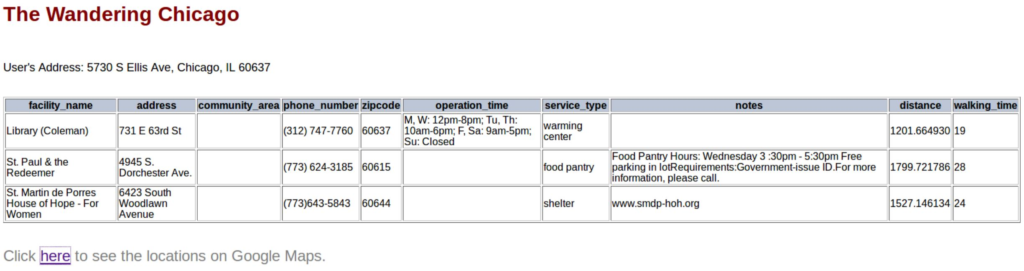
OUPUT：INFORMATION TABLE
Note: click on “here” will pop up a corresponding Google Map!
What we can know:
Facility name: the name of the facility
Address: address of the facility
Community area: which community they are in
Phone number: contact information
Operation time: when this facility is open
Service type: what kind of service they provide
Notes: other information
Distance: how far it is from the user’s location (meters)
Walking time: how long it takes to walk there

Slide 9
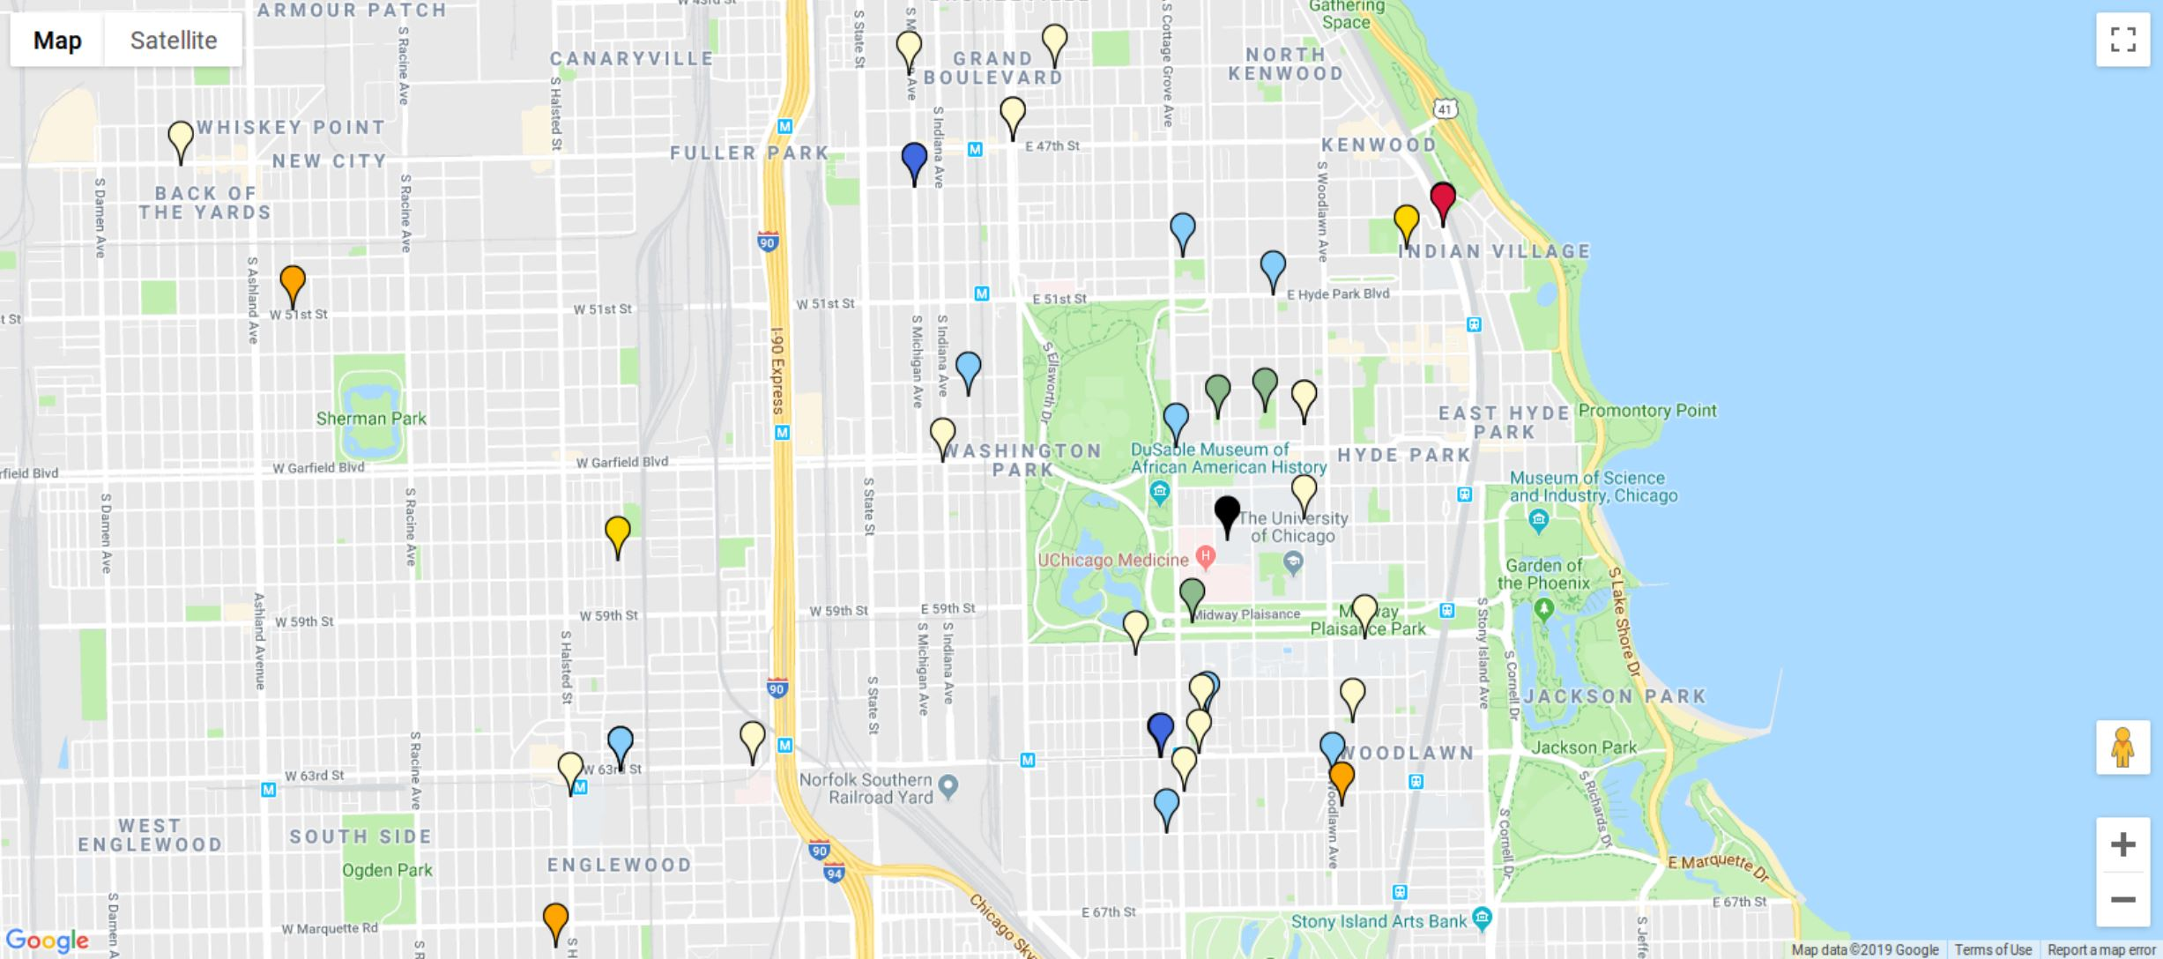

MAP

